Slide 1

www.donconnelly247.com

Slide 2
Today’s topics
Breaking out of the commodity trap
The connection between exemplary service and referrals
Harvard Business School case study of top sales people
The importance of storytelling
Getting clients off the fence
Getting clients off the fence

Slide 3
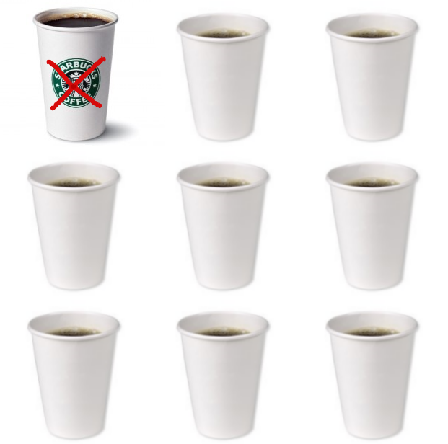
Breaking out of the commodity trap
$.02 or $5.00?

Slide 4
Five ways to distinguish yourself from the competition
A commoditized marketplace is one in which a number of companies offer similar products or similar services at similar prices with similar results. Presentations are similar, as are customer experiences. Products, presentations, sales efforts and service become commoditized.

Slide 5

1. The Ritual of Commoditization

Slide 6

2. Market yourself

Slide 7

3. Cross Sell

Slide 8
The Advantages of cross selling
Cross selling is about profitability
Clients who buy two or more products or services from you are much more loyal
Client attrition decreases
Every client has unmet needs and opportunities
  Increased revenue: Brokerage, investments, insurance, mortgages, banking
Your best client is your competition’s best prospect. He or she will buy these services elsewhere, if not from you
Wealthy people have a poverty of time. They want their own CFO

Slide 9



4. Never forget how important you are

Slide 10
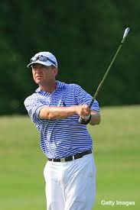
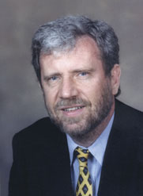


5. Embrace the monotony

Slide 11

Master and stick to the basics

Slide 12
Getting away from the basics
There is nothing more common than a talented, unsuccessful person
The trivial many or the gifted few? Dunwoody
Be excellent at what you do
  Excellence begins with an attitude. You are a CEO
Navy Seals
The more successful we become, the further we get away from the basics that made us successful in the first place
What causes us to get away from the basics?

Slide 13
Getting Away from the Basics
Sticking to the basics takes a blue collar mentality and sheer determination. It’s hard work.
Astronaut Mike Mullane calls it ‘Normalization of Deviance.’ We cut corners with no negative consequences, so we keep doing it. Eventually, we do not view our actions as substandard. The incorrect way becomes the acceptable way.
Cheese burger or salad? Get up and exercise or sleep in? Prospect or not? Cutting corners is easy!

Slide 14
Strengthen your core competency
Cerulli Associates 2009

Slide 15
How to get back to the Basics
  Expert performance comes from learning to do something right and then doing it right every time
  Deliberate practice; Davis Love; K. Anders Ericsson
Do not rely on your talent alone
Have a repeatable process

Slide 16
The Repeatable Process
Goals, Mission Statement
Business, Marketing Plans
Prospecting, Appointments, Listening, Presentation
Asking for the order and referrals
Managing the Relationship
Client Service Strategy

Slide 17
Exemplary service and referrals
“Have your car here Thursday at 9:00 AM”
Would you recommend a restaurant with excellent food and lousy service?
There is no book available listing great Canadian Advisors
Are you referable?
Referrals come from the inner circle. “Who do you know who should know me?”
If I had a magic wand, your business card would read 'By Referral Only'

Slide 18

Harvard Business School
“Most people can be top sellers if they are willing to study, concentrate and focus on their performance.”

Slide 19
The Eight Shared Qualities
#1: They did not take “no” personally and allow it to make them feel like a failure. They had high levels of confidence and self-esteem. They were not devastated by rejection.
  The behavior of the top tier Advisors is different because their perception of who they are is different. They have high self-esteem
  Mike Piscopo @ 15 handicap

Slide 20
The Eight Shared Qualities
#2: They took 100% acceptance of responsibility for results. They didn’t point the finger when times got tough. The worse things got, the harder they worked. They used negatives to their advantage.
  Attitude
          Have decided to become great
          Have chosen to be optimistic
  Think like lifers

Slide 21
The Eight Shared Qualities
#3: They had above average ambition and desire to succeed. This quality enabled them to determine proper priorities. It also determined with whom they associated and how they spent their time on and off the job.
#4: They had high levels of empathy. They were able to put themselves into their clients’ shoes and appropriately respond to their needs
  180 Months, 240 Paychecks, Last car vs. First house

Slide 22
The Eight Shared Qualities
#5: They were intensely goal-oriented. They knew exactly where they were going and were able to minimize distractions.
#6: They had above average will power and determination. They always persist toward their goals
          Bamboo plants

Slide 23
The Eight Shared Qualities
#7: They were impeccably honest with themselves and their clients. This allows them to gain each client’s trust
#8: They had an ability to approach strangers even if it was uncomfortable.
  Sharpen your practical knowledge

Slide 24
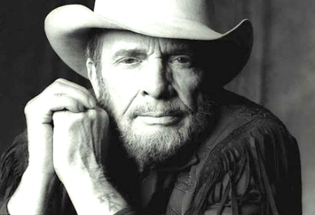
The importance of storytelling

Slide 25
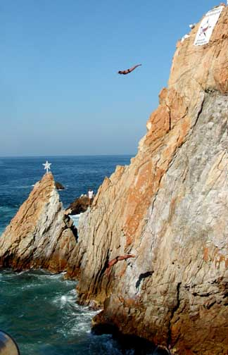
Managing client behavior
Acapulco cliff divers
Tuna Fish
Brick through the window
Sale at Harry Rosen’s
12” ruler
Soar and plunge

Slide 26

Investing wisdom
        Investing is like buying seasonal clothing
        The beach ball under water
        Q + T & D = R/W
        10% drop = one stride

Slide 27

Diversification
Fifty pencils
Three lanes of traffic
Women’s shoes

Slide 28
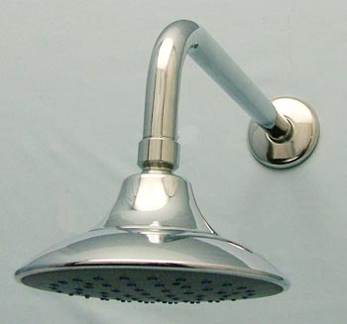
Dollar Cost Averaging
        Investing money is like taking a shower

Slide 29

Fees and Commissions
        Commission conscious or results conscious?
        “The amount of money you will pay me in fees or commissions will not change my life. It will change your life.”

Slide 30

“I want to think it over”
        Sixty miles in one hour
        Tailor’s measuring tape

Slide 31

Maintaining a long term perspective
        DOB, HS graduation date, wedding date
        Strawberry plants
        Driving from Vancouver to Montreal
        If you’re 49 years old . . .
        You are a train conductor

Slide 32

Why should I do business with you?
        Airline pilot story
        Barack Obama
        Kernel of corn
        Compass and map
        Monthly haircuts

Slide 33

Prospecting Ideas

Slide 34

Prospecting Ideas
        The $7 cake

Slide 35

Overcoming Objections
There are only three objections you can get

Slide 36

Getting clients off the fence

Slide 37

Get your clients off the fence
“Do you know what investing for the long run but listening to market news every day is like? It's like a man walking up a big hill with a yo-yo and keeping his eye fixed on the yo-yo instead of the hill."
Alan Abelson

Slide 38
Get them off the fence!
“Bob/Mary, can you take professional advice even though you may disagree with it?”
Appreciate why clients are on the fence
Be confident in your opinion
Be enthusiastic
Be positive about what lies ahead
Refocus your clients on the long term

Slide 39
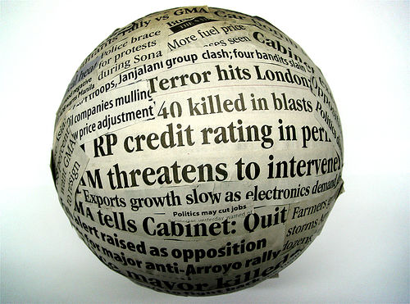
The investor’s greatest challenge is staying invested in the face of bad news
This time it’s different

Slide 40
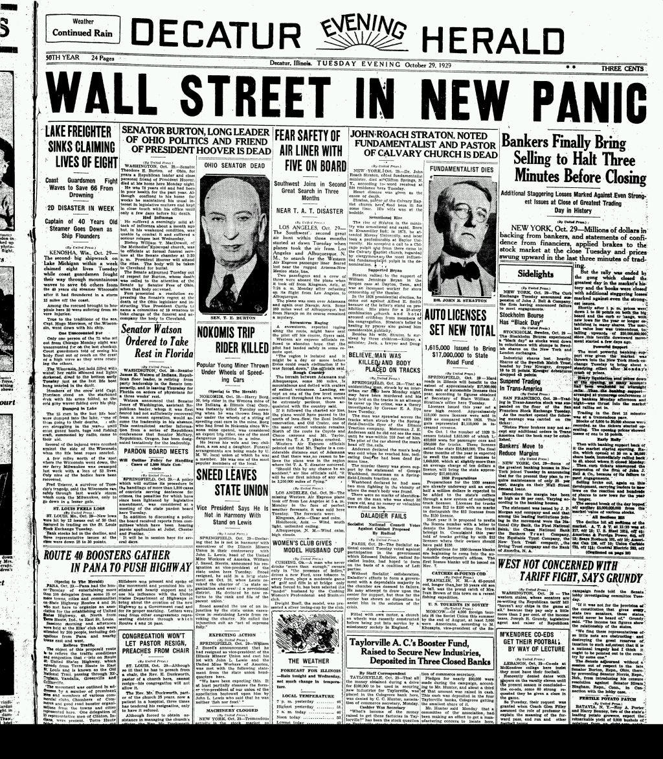
It’s Never Different!!

Slide 41
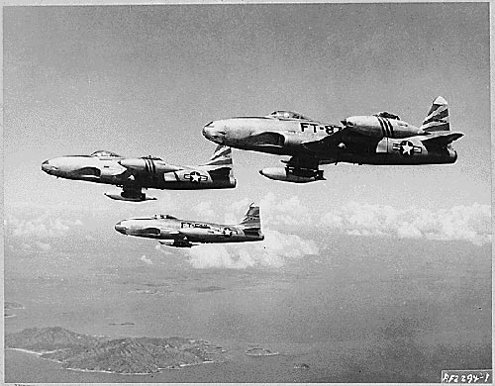
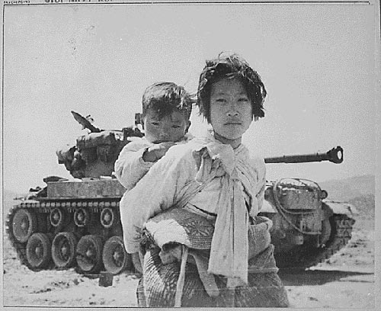

Notes:
The Korean War

Slide 42


Notes:
Soviets test atom bomb

Slide 43
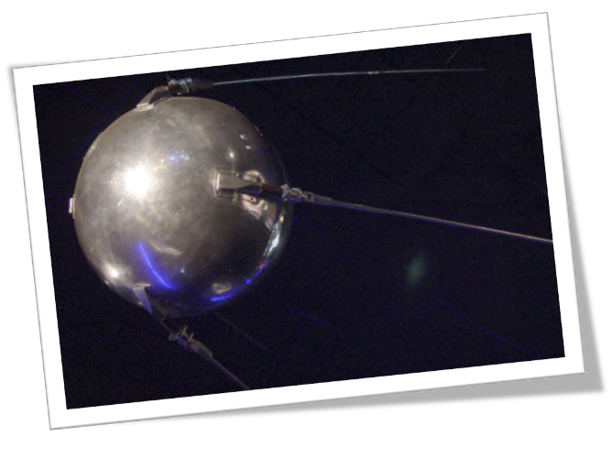


Notes:
Soviets launch Sputnik

Slide 44
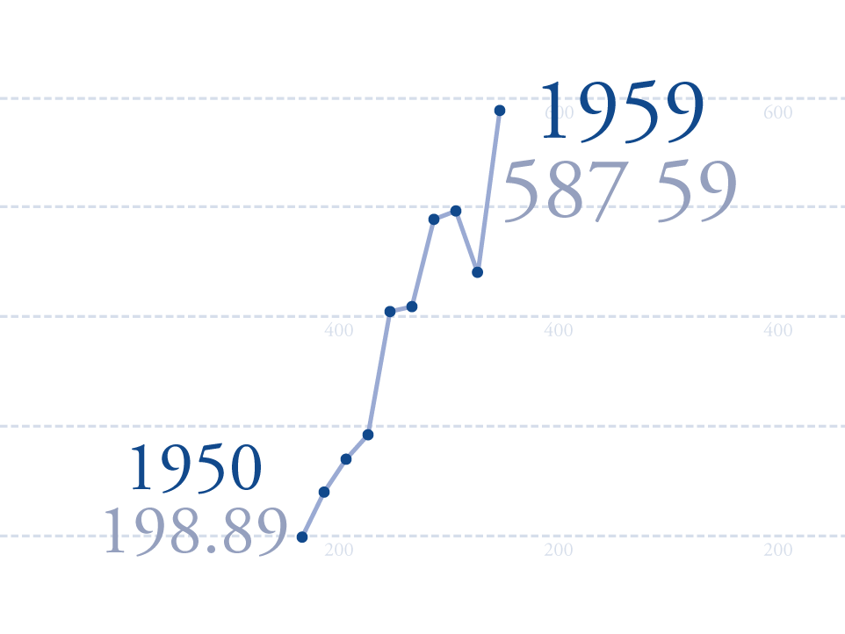
Notes:
Soviets launch Sputnik

Slide 45
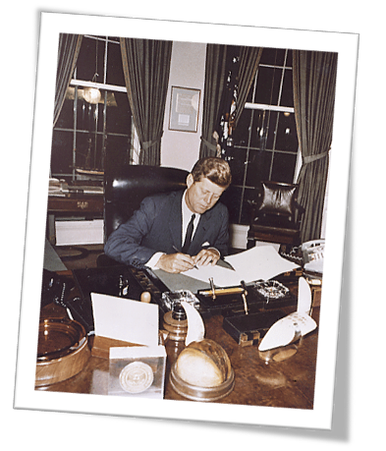

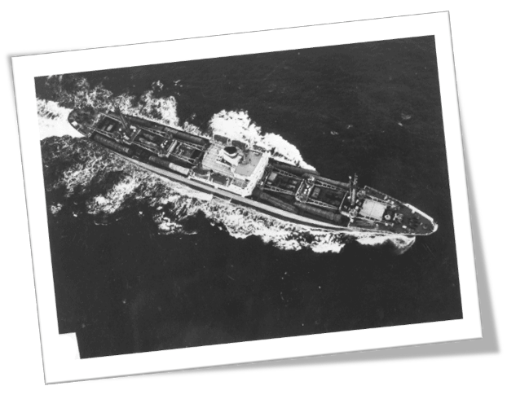
Notes:
Cuban Missile Crisis

Slide 46
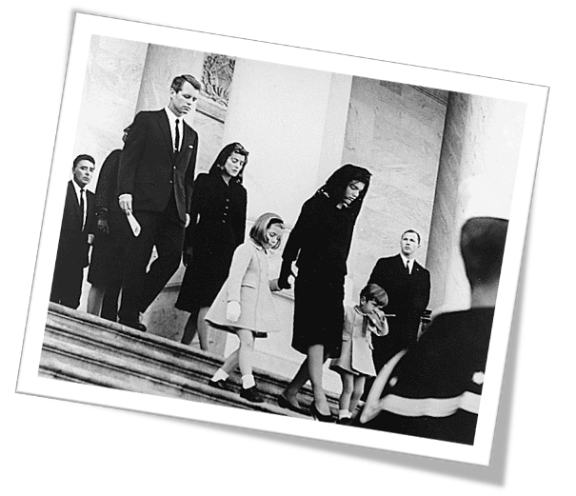
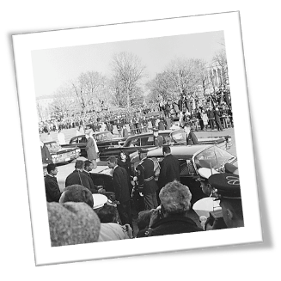
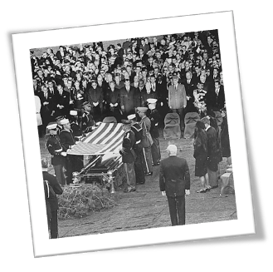

Notes:
JFK assassinated

Slide 47
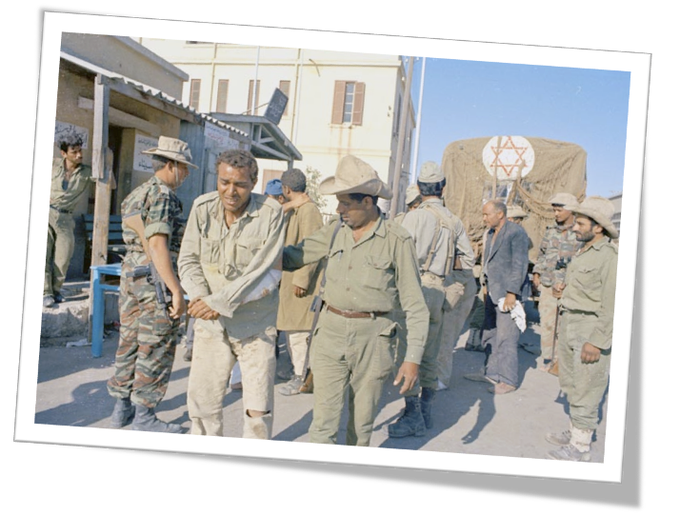

Notes:
Six Days War

Slide 48

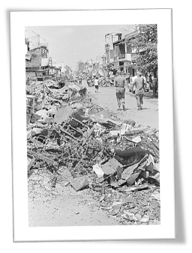
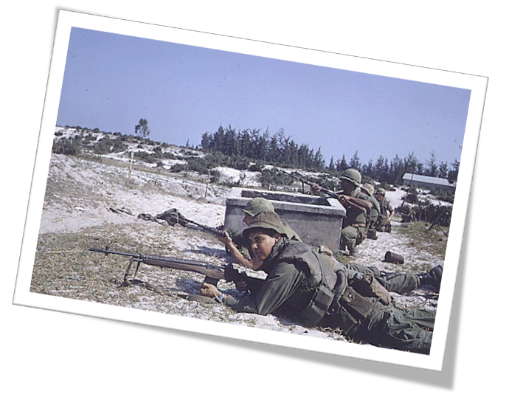

Notes:
Tet Offensive

Slide 49
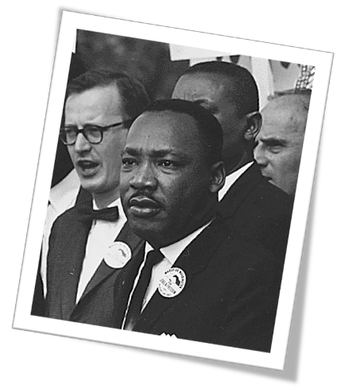
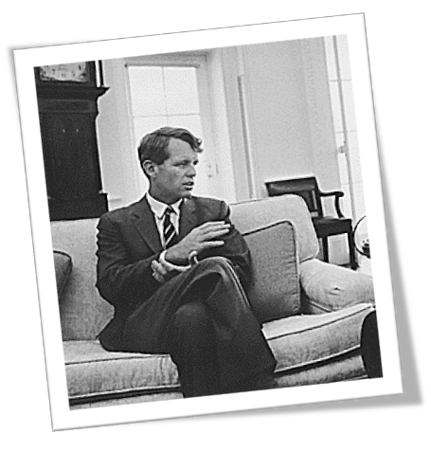
Notes:
MLK and RFK assassinated

Slide 50
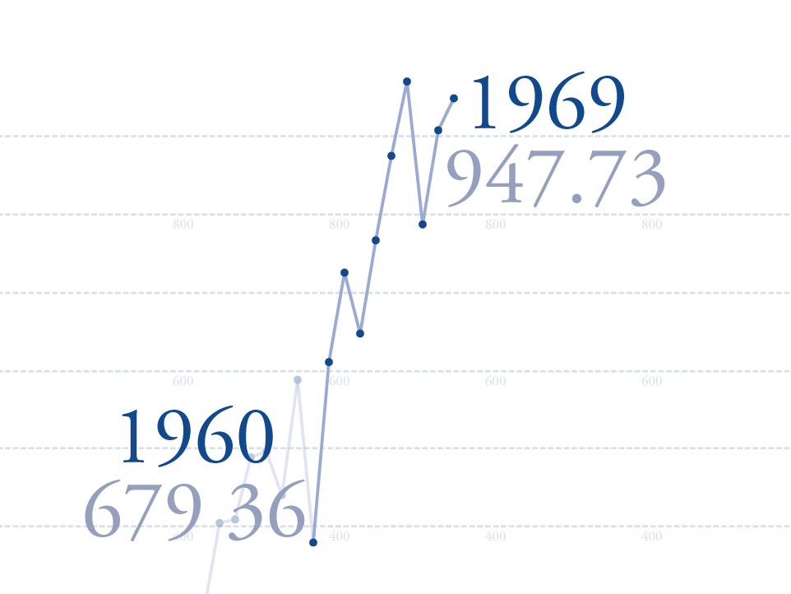
Notes:
MLK and RFK assassinated

Slide 51
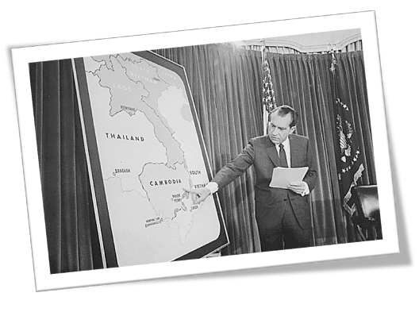
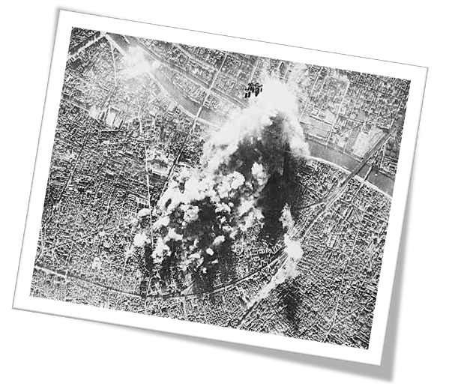

Notes:
USA bombs Cambodia

Slide 52


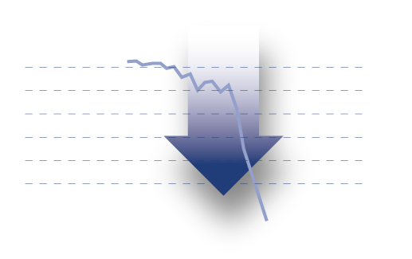
Notes:
Bear Market

Slide 53
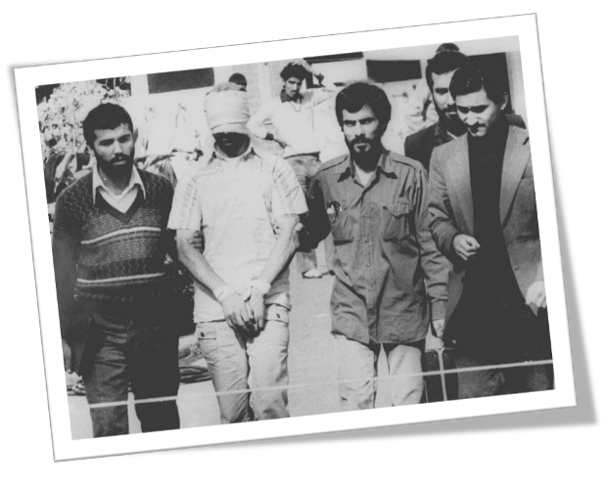

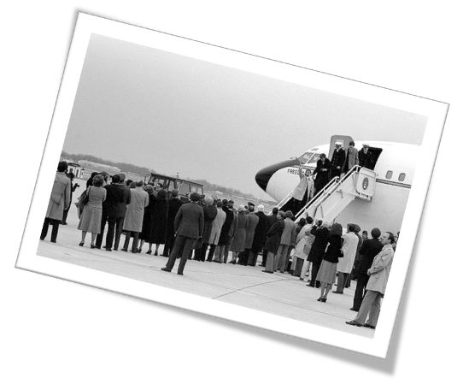
Notes:
Iran hostage crisis

Slide 54
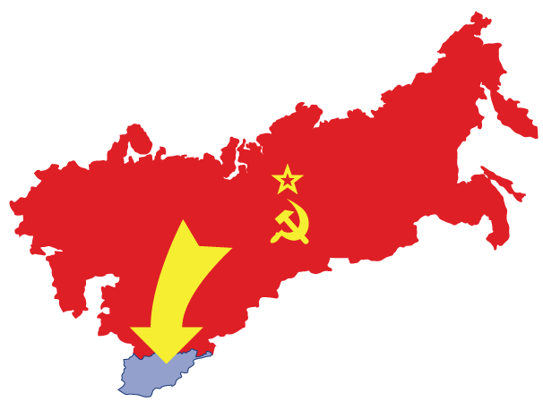
Notes:
Soviets invade Afghanistan

Slide 55
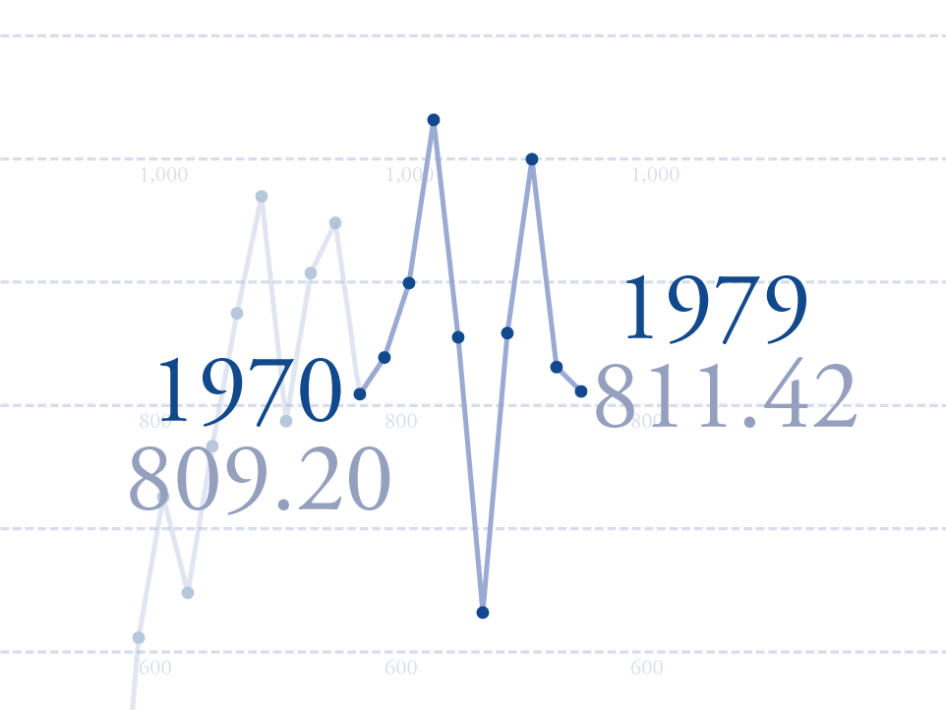
Notes:
Soviets invade Afghanistan

Slide 56
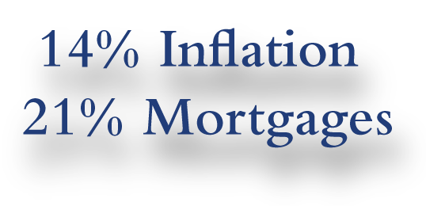

Notes:
14% inflation and 21% mortgages

Slide 57
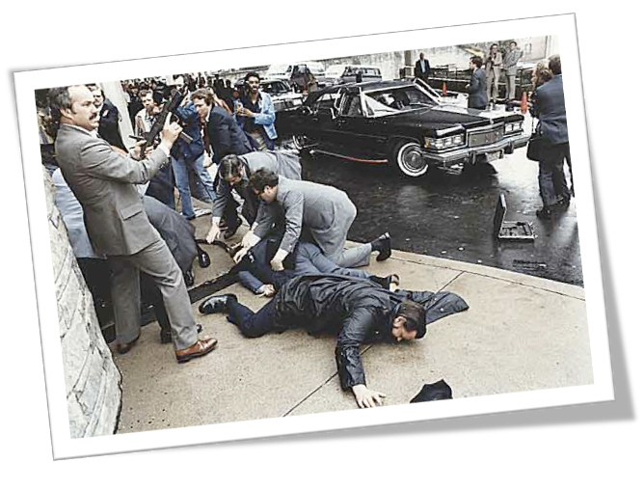
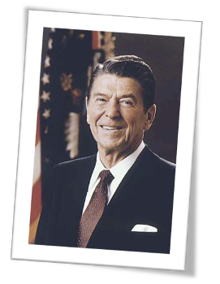

Notes:
President Reagan shot

Slide 58

Notes:
Market crash!

Slide 59

Notes:
Iran Contra

Slide 60
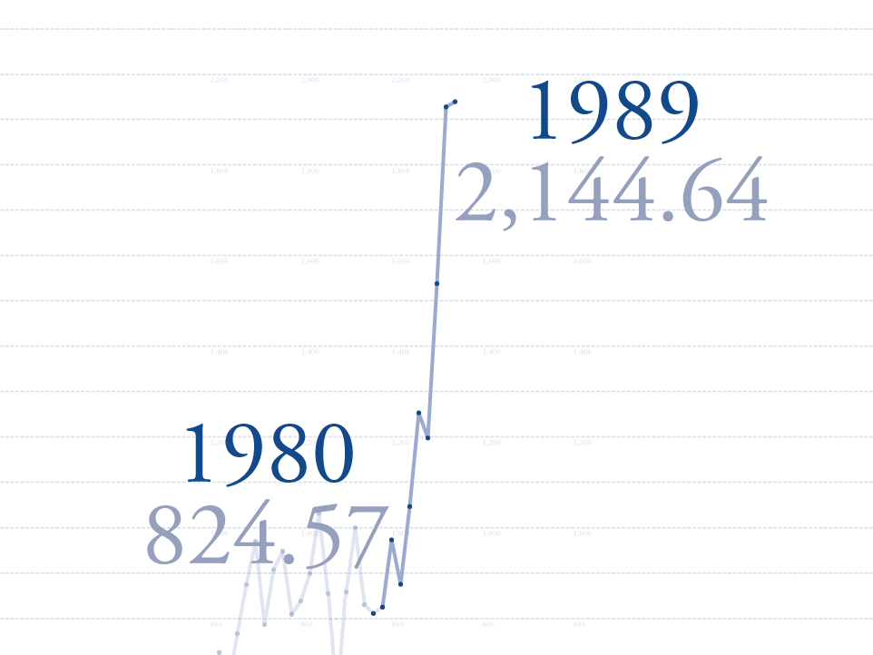
Notes:
USA invades Panama

Slide 61
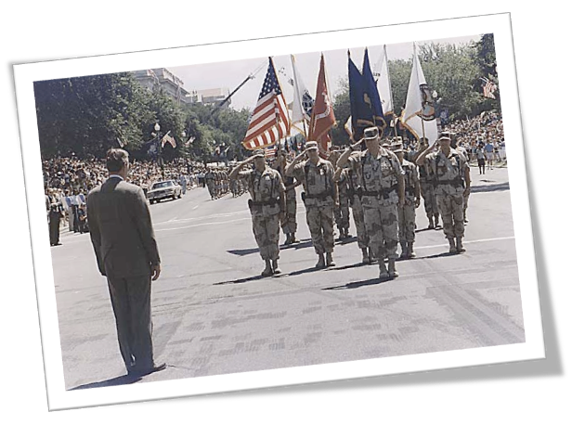


Notes:
Persian Gulf War

Slide 62
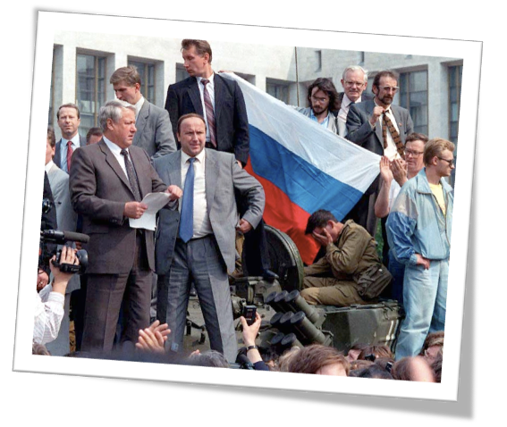
Notes:
Attempted Coup in the Soviet Union

Slide 63


Notes:
Mexican currency crisis

Slide 64
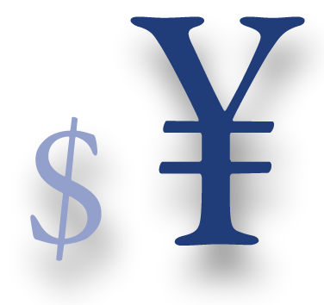

Notes:
Asian Contagion

Slide 65
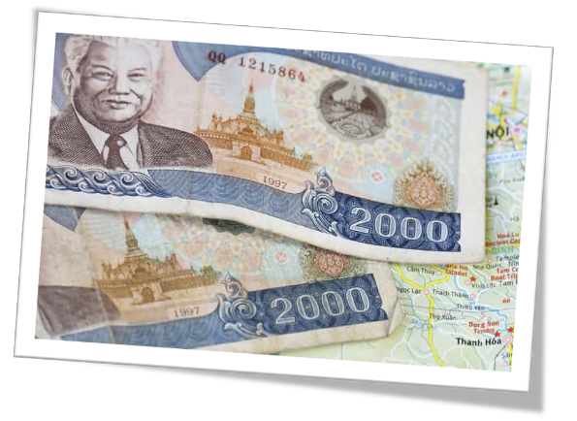

Notes:
Soviet bond default

Slide 66



Notes:
Y2K Scare

Slide 67
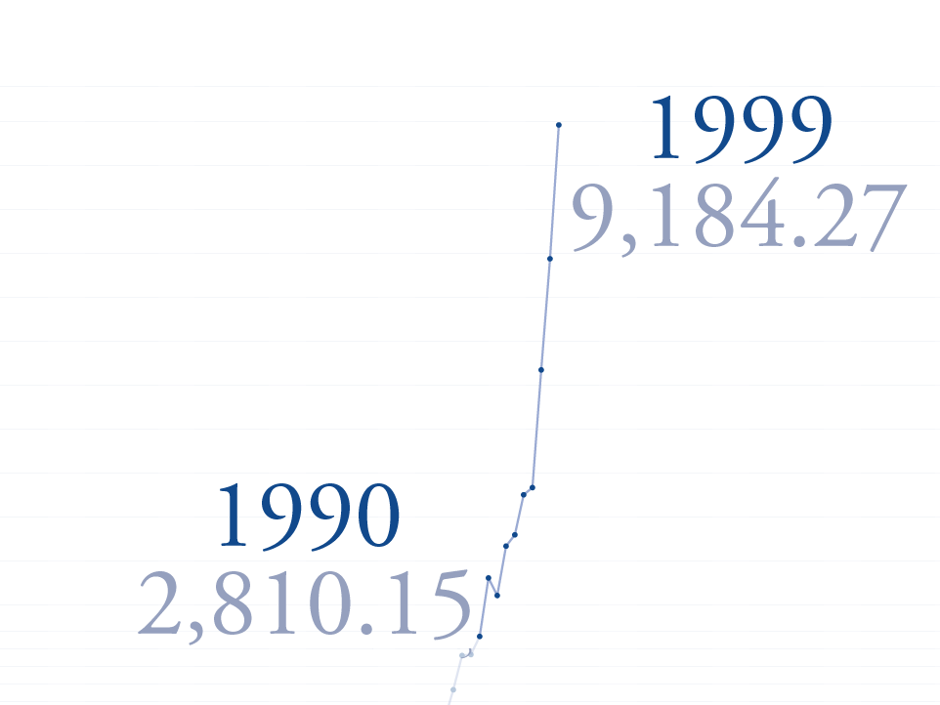
Notes:
Y2K Scare

Slide 68
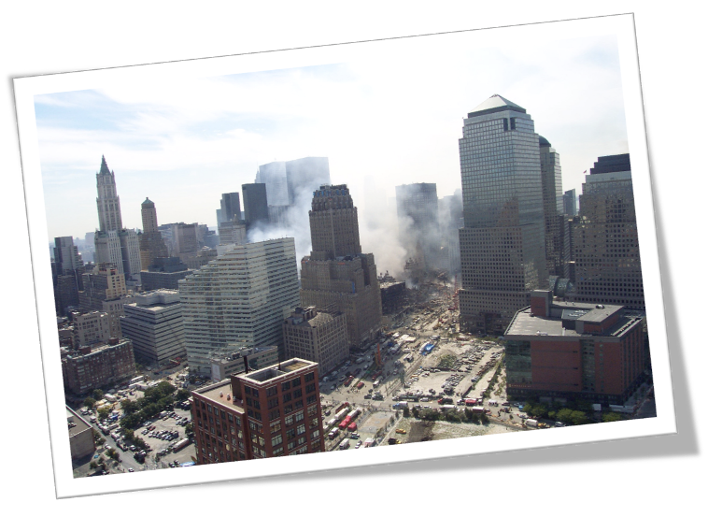


Notes:
911

Slide 69

Notes:
USA invades Iraq

Slide 70



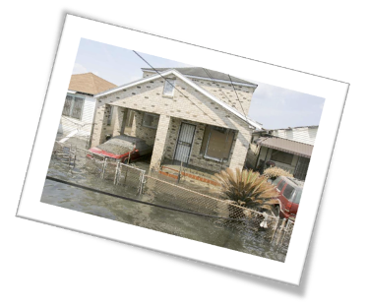
Notes:
Hurricane Katrina

Slide 71
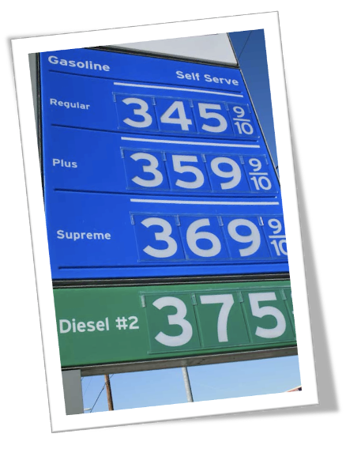
Notes:
Gas prices skyrocket

Slide 72
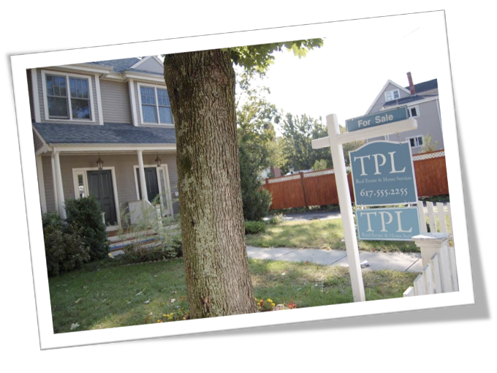

Notes:
Real estate prices dip

Slide 73

Notes:
Market Crashes Again.

Slide 74


Notes:
Bear Market

Slide 75
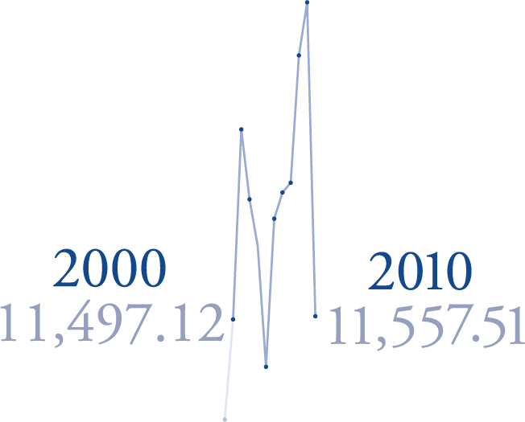
Notes:
Bear Market

Slide 76
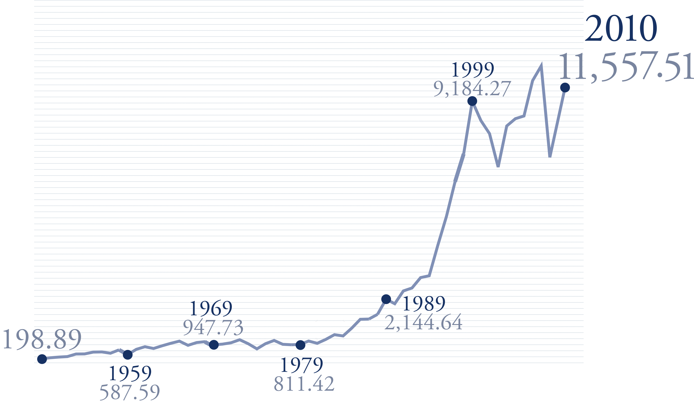
Notes:
Bear Market

Slide 77
In Conclusion
Excellence is doing the ordinary things extraordinarily well
Two things never change
I have never met a successful pessimist
Three things must happen in order for someone to do business with you
Make sure you’re the logical choice

