Slide 1

www.donconnelly247.com

Slide 2
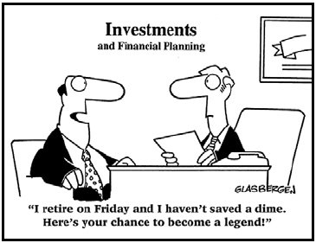

Slide 3
Differentiate or Die
Break out of the commodity trap
Harvard Business School case study of top sales people
Strengthen your core competency
Get clients off the fence
Getting clients off the fence

Slide 4
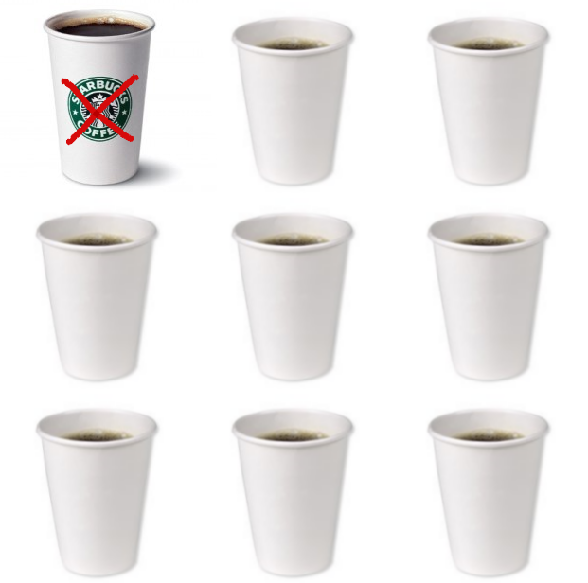
Breaking out of the commodity trap
$.02 or $5.00?

Slide 5
Three ways to break out
Find your success DNA
Market yourself
Be brilliant at the basics

Slide 6

Find your success DNA
The ritual of commoditization

Slide 7
Seven ways to be different
Understand people are not trying to become rich
  Tom Stanley
Outwork the competition
  Successful people do what unsuccessful people won’t do
  Half the people in your business are below average by definition
Never forget how important you are
Do not rely on your talent alone. Strive to develop your skills

Slide 8
Seven ways to stand apart from the crowd
Provide outstanding service. Americans have forgotten what excellent service is
Be excellent at what you do
  Stop doing less than excellent work today
  Excellence begins with an attitude
  Keep it simple. You’re not paid on how much you know. You’re paid on how well you communicate what you do know
          The airline pilot story
          The brick through the window
          Barack Obama cutout

Slide 9

Market yourself
People want to know what you can do for them

Slide 10

Be brilliant at the basics

Slide 11
Being brilliant at the basics
Be one of the gifted few, not one of the trivial many
  Bob Dunwoody
  How does one become brilliant at the basics?
  Navy SEALS; Deliberate practice; K. Anders Ericsson
Yet for most of us, the more successful we become, the further we get away from the basics that made us successful in the first place. Why?

Slide 12
Getting away from the basics
Because sticking to the basics takes a blue collar mentality and sheer determination. It’s hard work.
Cutting corners, Mike Mullane and the ‘Normalization of Deviance.’ We cut corners with no negative consequences, so we keep doing it. Eventually, we do not view our actions as substandard. The incorrect way becomes the acceptable way.
  Sleeping in, cheeseburgers and Jerry Seinfeld
Learn a repeatable process and don’t break the chain

Slide 13
The Repeatable Process
Goals
Mission Statement
Business Plan
Marketing Plan
Prospecting
Appointment
Listening
Presentation
Commitment
Referrals
Relationship Management
Outstanding Service

Slide 14

II. HBS case study of top sales people
“Most people can be top sellers if they are willing to study, concentrate and focus on their performance.”

Slide 15
The Eight Shared Qualities
#1: They did not take “no” personally and allow it to make them feel like a failure. They had high levels of confidence and self-esteem. They were not devastated by rejection.
  The behavior of the top tier Advisors is different because their perception of who they are is different. They have high self-esteem
  Mike Piscopo @ 15 handicap

Slide 16
The Eight Shared Qualities
#2: They took 100% acceptance of responsibility for results. They didn’t point the finger when times got tough. The worse things got, the harder they worked. They used negatives to their advantage.
  Attitude
          Have decided to become great
          Have chosen to be optimistic
  Think like lifers
  They have blue collar heartbeats

Slide 17
The Eight Shared Qualities
#3: They had above average ambition and desire to succeed. This quality enabled them to determine proper priorities. It also determined with whom they associated and how they spent their time on and off the job.
#4: They had high levels of empathy. They were able to put themselves into their clients’ shoes and appropriately respond to their needs
  180 Months, 240 Paychecks

Slide 18
The Eight Shared Qualities
#5: They were intensely goal-oriented. They knew exactly where they were going and were able to minimize distractions.
#6: They had above average will power and determination. They always persist toward their goals
          Bamboo plants

Slide 19
The Eight Shared Qualities
#7: They were impeccably honest with themselves and their clients. This allows them to gain each client’s trust
  Three things must happen for someone to do business with you
#8: They had an ability to approach strangers even if it was uncomfortable.
  Sharpen your practical knowledge

Slide 20
III. Strengthening your core competency
Cerulli Associates 2009

Slide 21
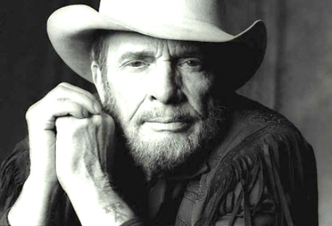
Don’t sing the words. Tell the story

Slide 22
Become a great storyteller
  You’re not paid on how much you know. You’re paid on how well you communicate what you do know. Storytelling is the single most powerful medium for getting your ideas across
  The U. S. Secret Service
  Everyone loves a storyteller
  If everyone understood everything you said, you would be one of the wealthiest people on earth

Slide 23
Find simplicity out of clutter – Albert Einstein
Make having the simplest presentation possible your goal
The simplest presentation is the best one
Take out of your presentation all that is unnecessary. If you do that well enough, only the necessary remains. It’s the necessary that your clients and prospects will find compelling
Make the complicated simple through the use of storytelling

Slide 24
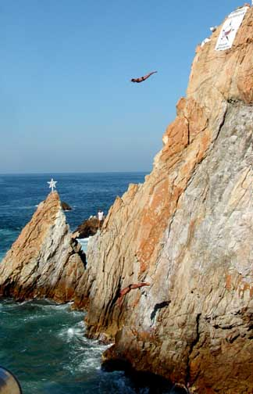
Managing client behavior
Acapulco cliff divers
Tuna fish
Brick through the window
Sale at Nordstrom’s
12” ruler
Soar and plunge

Slide 25

Investing wisdom
        Invest your money the same way you buy seasonal clothing
        The beach ball under water
        Q + T + D = R/W
        10% drop = one stride in a 36’ room

Slide 26

Diversification
Fifty pencils
Three lanes of traffic
Women’s shoes

Slide 27
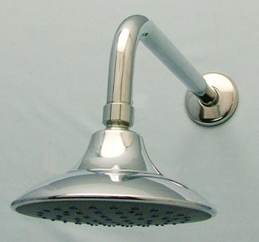
Dollar Cost Averaging
        Investing money is like taking a shower

Slide 28

Fees and Commissions
        Commission conscious or results conscious?
        “The amount of money you will pay me in fees or commissions will not change my life. It will change your life.”

Slide 29

“I want to think it over”
        Sixty miles in one hour
        Tailor’s measuring tape

Slide 30
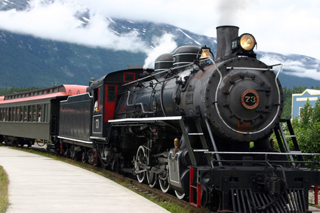
Maintaining a long term perspective
        DOB, HS graduation date, wedding date
        Strawberry plants
        You are a train conductor

Slide 31

Why should I do business with you?
        Airline pilot story
        Kernel of corn
        Compass and map
        Monthly haircuts

Slide 32

All the data has been commoditized
  Your speaking style cannot be easily copied

Slide 33

IV. Getting clients off the fence

Slide 34
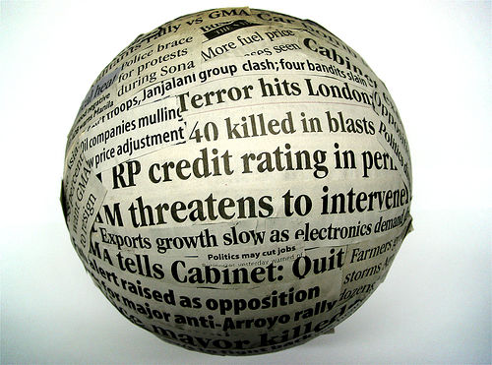
The investor’s greatest challenge is staying invested in the face of bad news
This time it’s different

Slide 35

Tell them a great long-term story
“Do you know what investing for the long run but listening to market news every day is like? It's like a man walking up a big hill with a yo-yo and keeping his eye fixed on the yo-yo instead of the hill."
Alan Abelson

Slide 36
Tolerance, perception and recency bias
Appreciate why clients are on the fence
Be confident in your opinion
Be enthusiastic
Be positive about what lies ahead
Refocus your clients on the long term

Slide 37
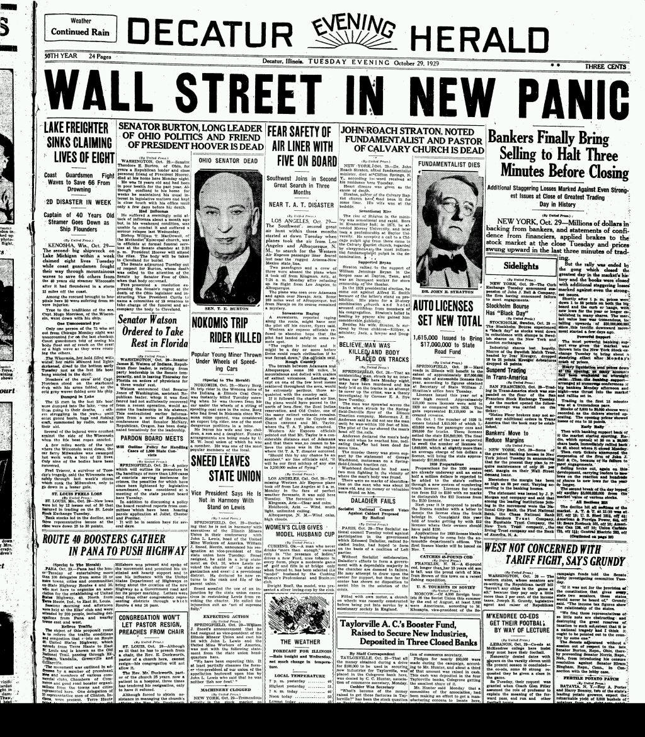
It’s Never Different!!

Slide 38
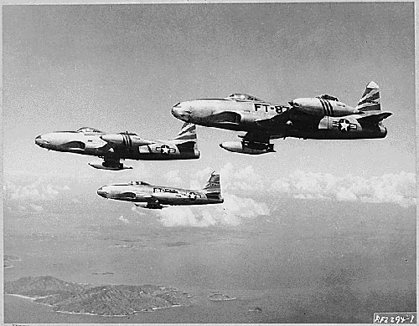
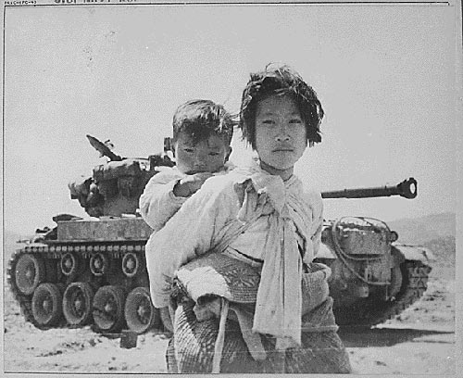

Notes:
The Korean War

Slide 39


Notes:
Soviets test atom bomb

Slide 40
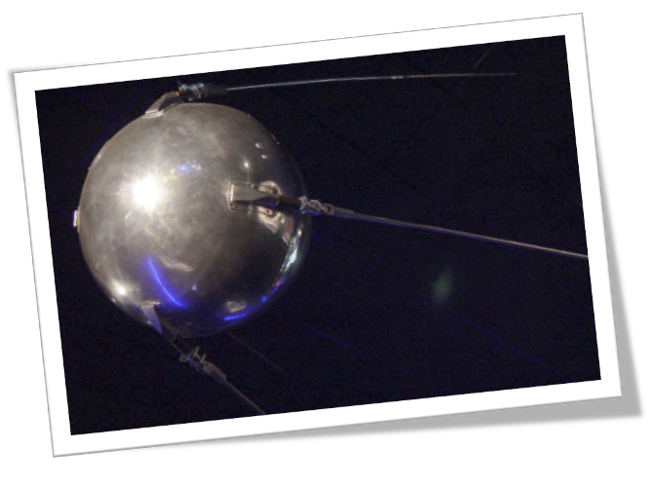


Notes:
Soviets launch Sputnik

Slide 41
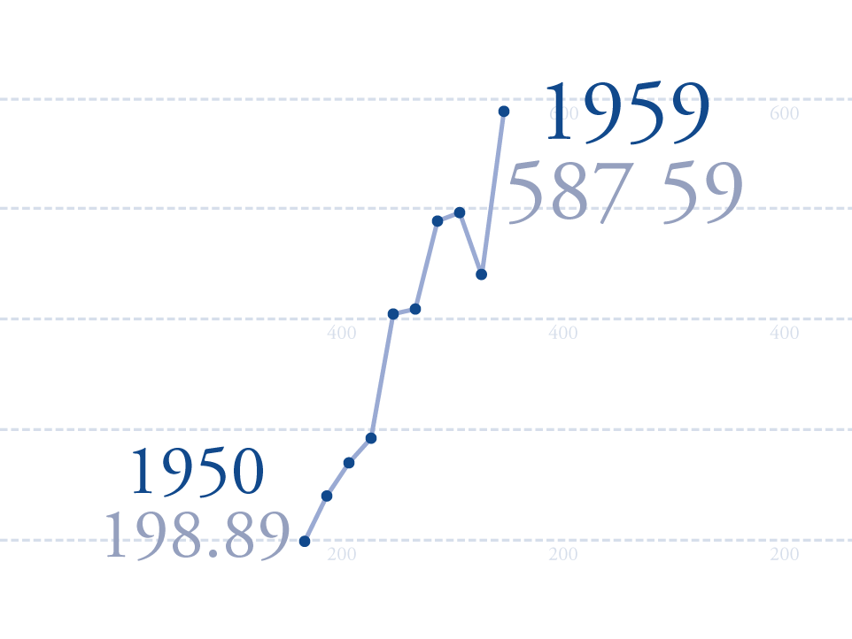
Notes:
Soviets launch Sputnik

Slide 42
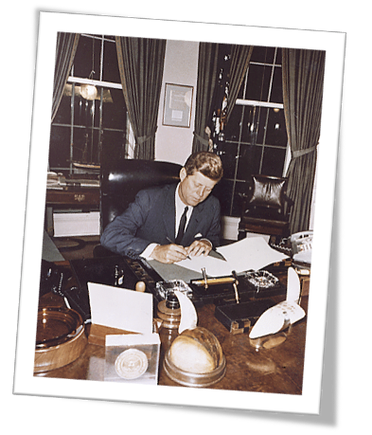

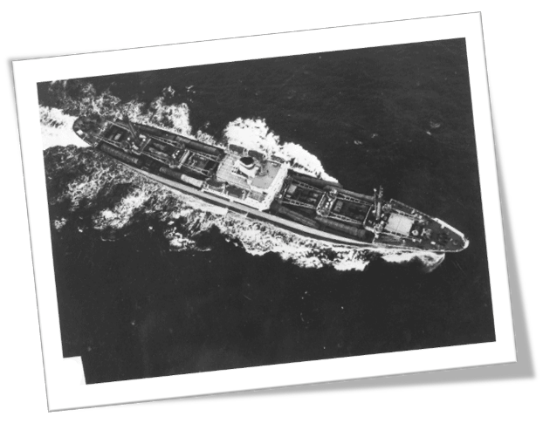
Notes:
Cuban Missile Crisis

Slide 43
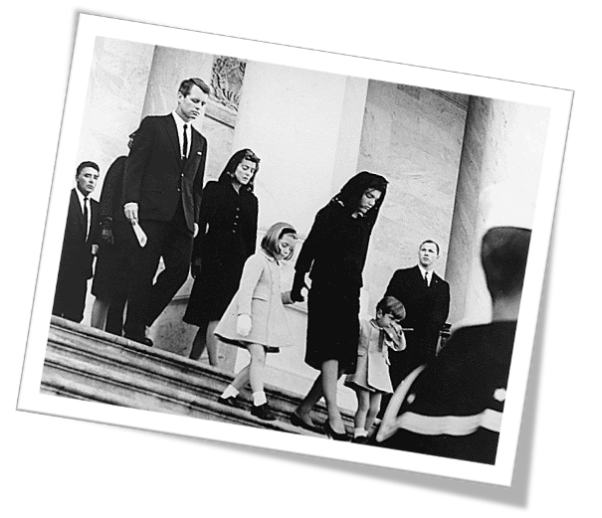
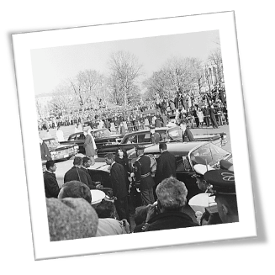
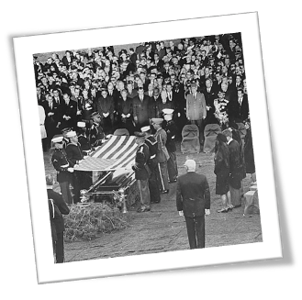

Notes:
JFK assassinated

Slide 44
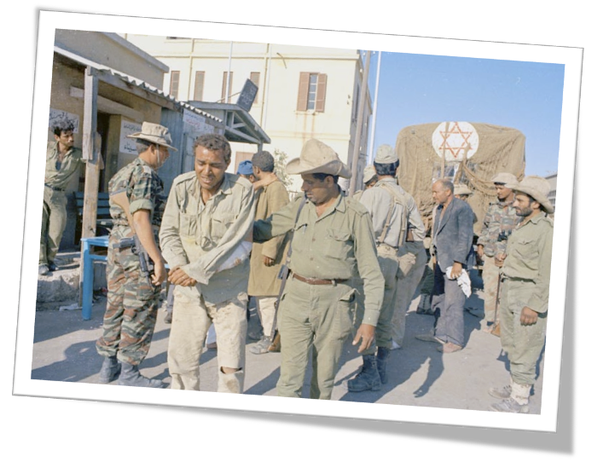

Notes:
Six Days War

Slide 45
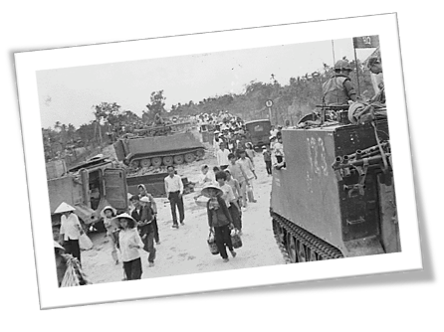
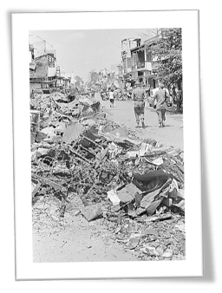
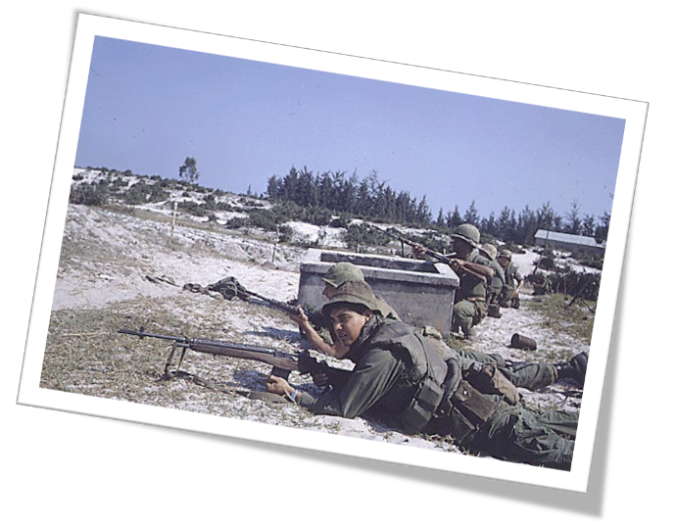

Notes:
Tet Offensive

Slide 46
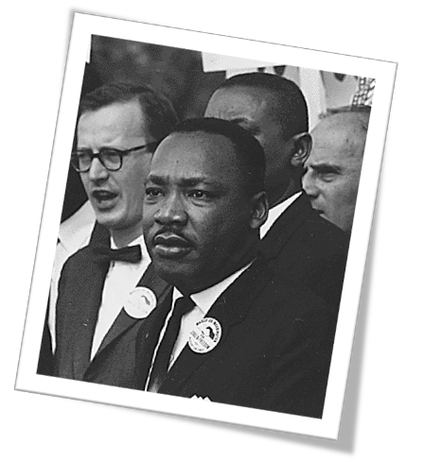
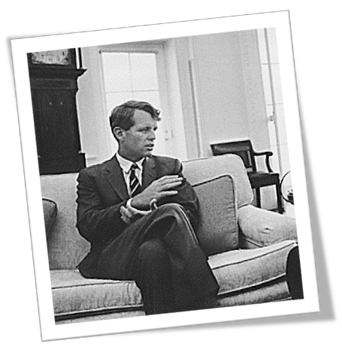
Notes:
MLK and RFK assassinated

Slide 47
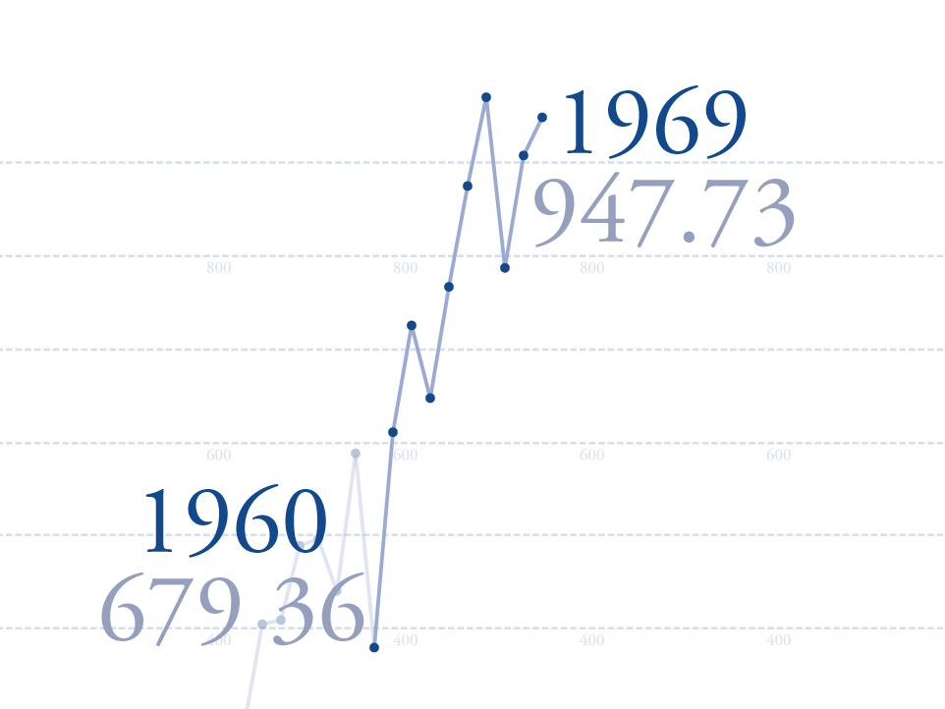
Notes:
MLK and RFK assassinated

Slide 48
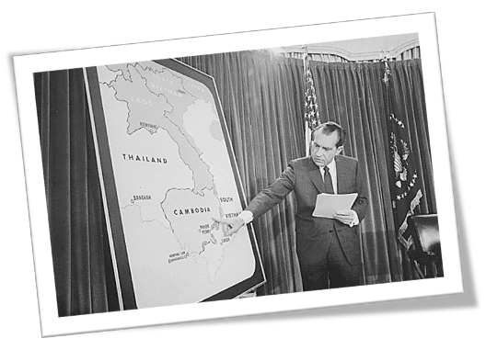
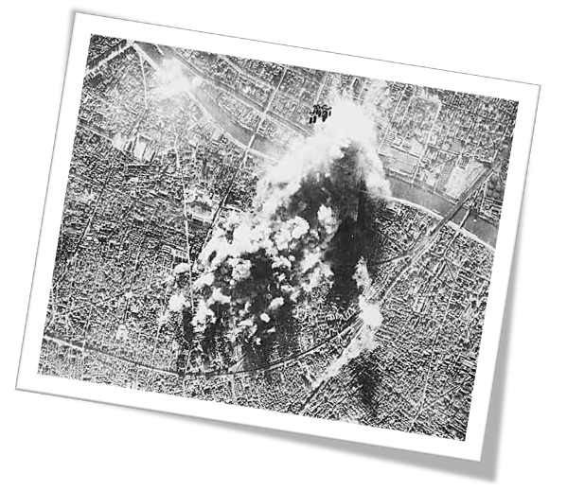

Notes:
USA bombs Cambodia

Slide 49


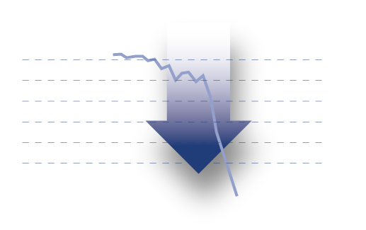
Notes:
Bear Market

Slide 50
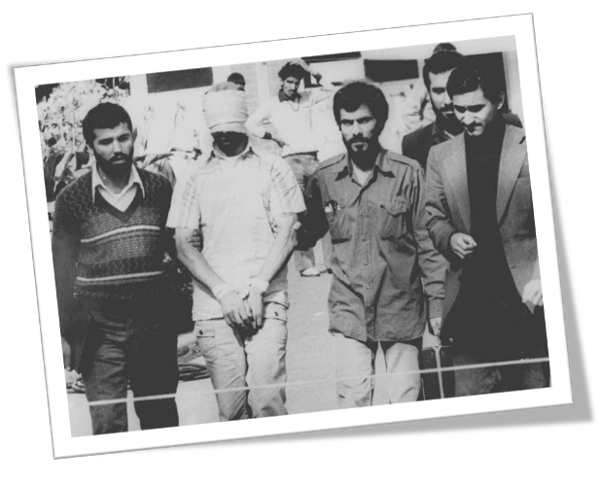

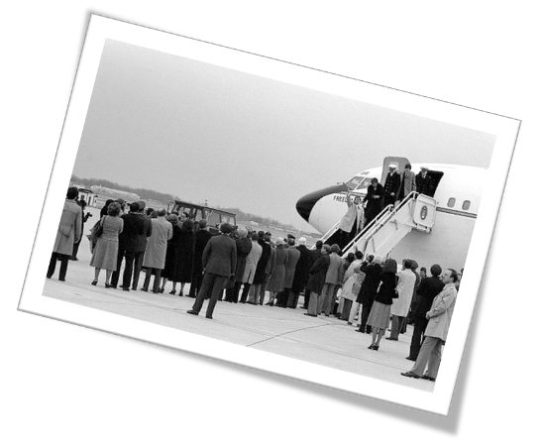
Notes:
Iran hostage crisis

Slide 51
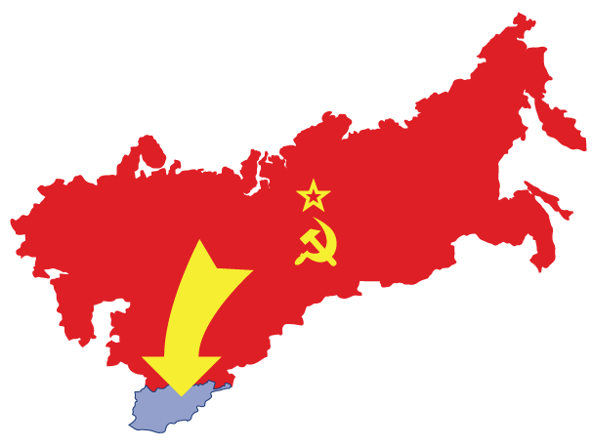
Notes:
Soviets invade Afghanistan

Slide 52
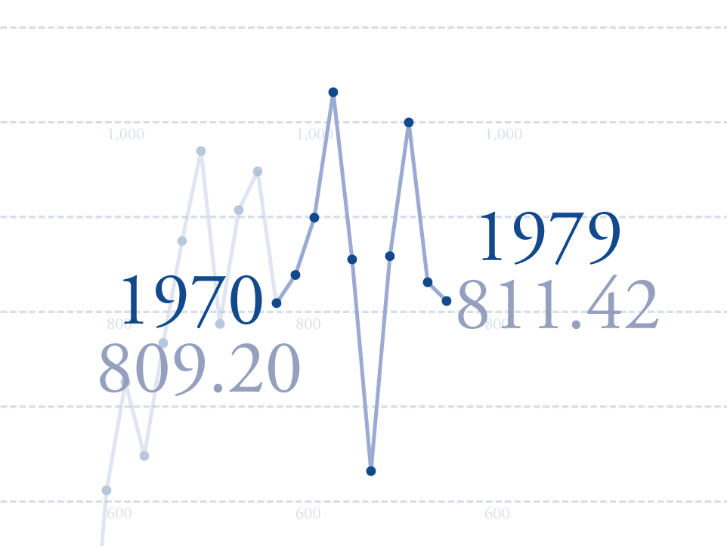
Notes:
Soviets invade Afghanistan

Slide 53
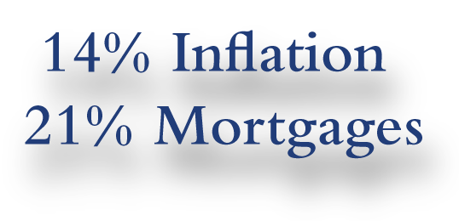

Notes:
14% inflation and 21% mortgages

Slide 54
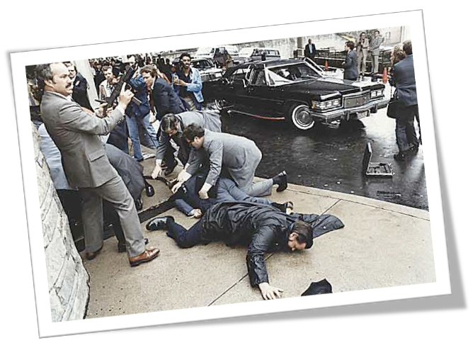
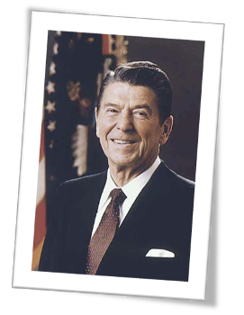

Notes:
President Reagan shot

Slide 55

Notes:
Market crash!

Slide 56
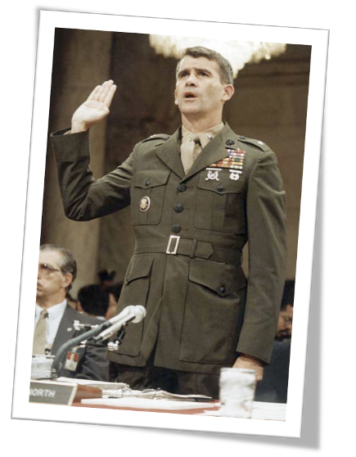
Notes:
Iran Contra

Slide 57
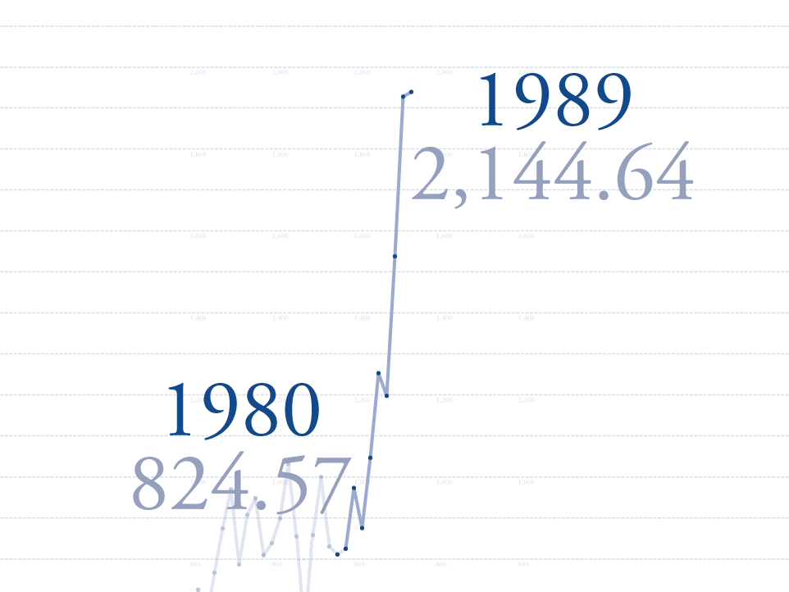
Notes:
USA invades Panama

Slide 58
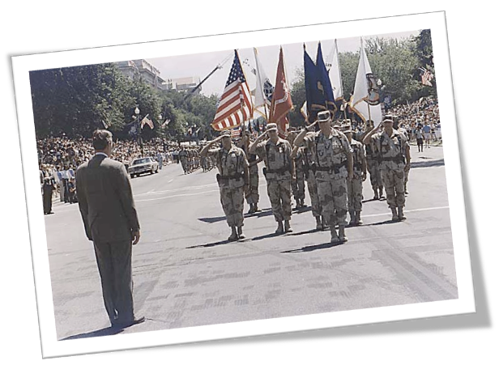


Notes:
Persian Gulf War

Slide 59
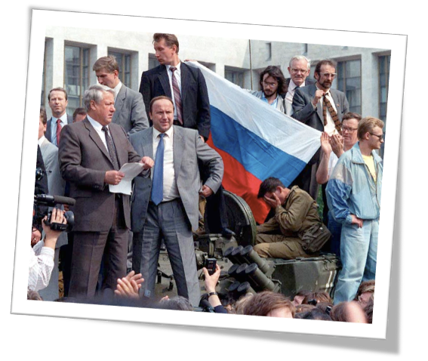
Notes:
Attempted Coup in the Soviet Union

Slide 60
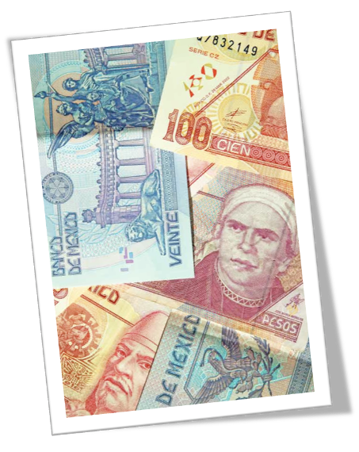

Notes:
Mexican currency crisis

Slide 61
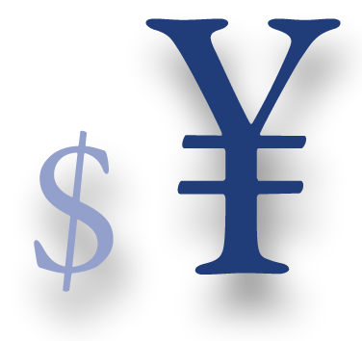

Notes:
Asian Contagion

Slide 62
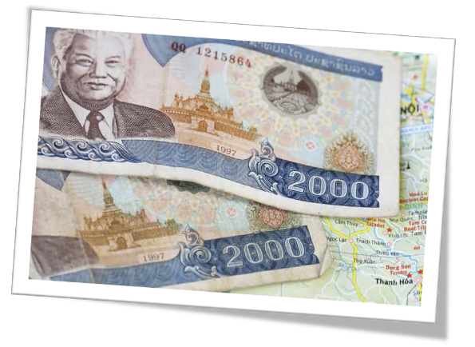

Notes:
Soviet bond default

Slide 63



Notes:
Y2K Scare

Slide 64
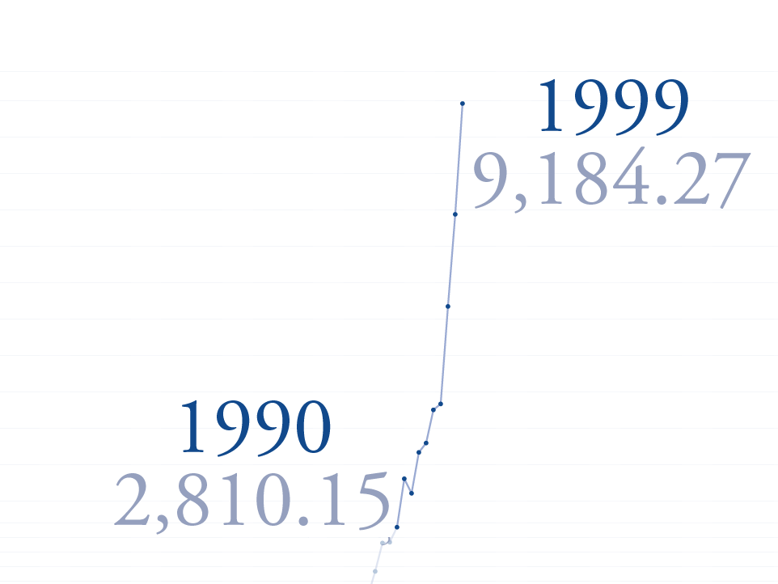
Notes:
Y2K Scare

Slide 65
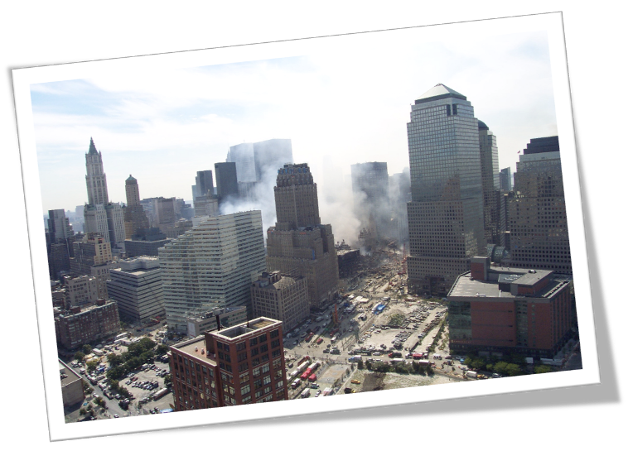


Notes:
911

Slide 66

Notes:
USA invades Iraq

Slide 67
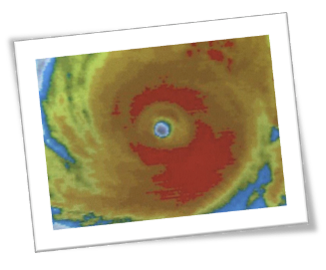


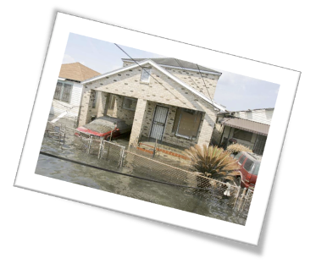
Notes:
Hurricane Katrina

Slide 68
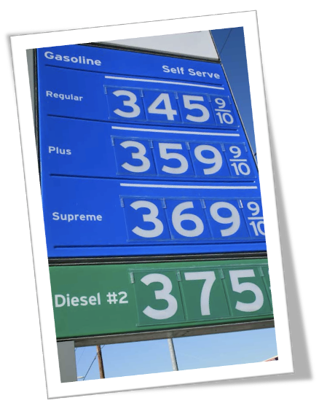
Notes:
Gas prices skyrocket

Slide 69
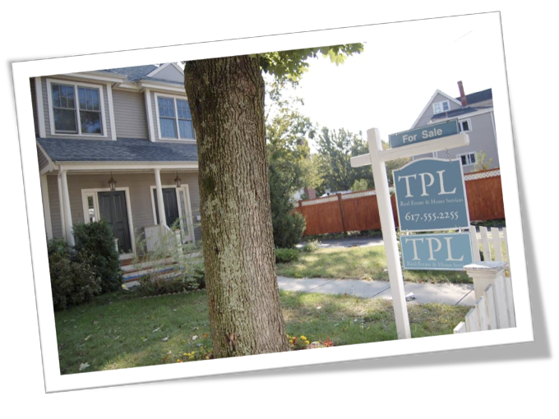

Notes:
Real estate prices dip

Slide 70

Notes:
Market Crashes Again.

Slide 71


Notes:
Bear Market

Slide 72
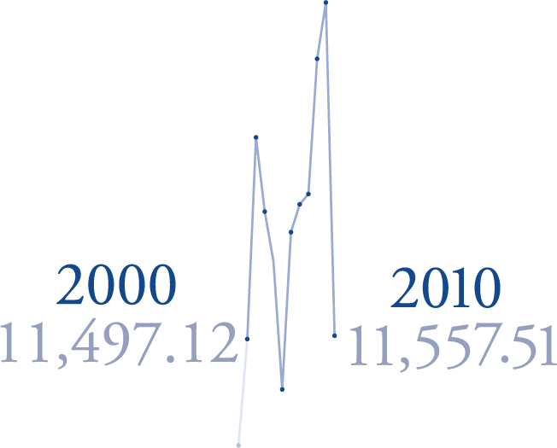
Notes:
Bear Market

Slide 73
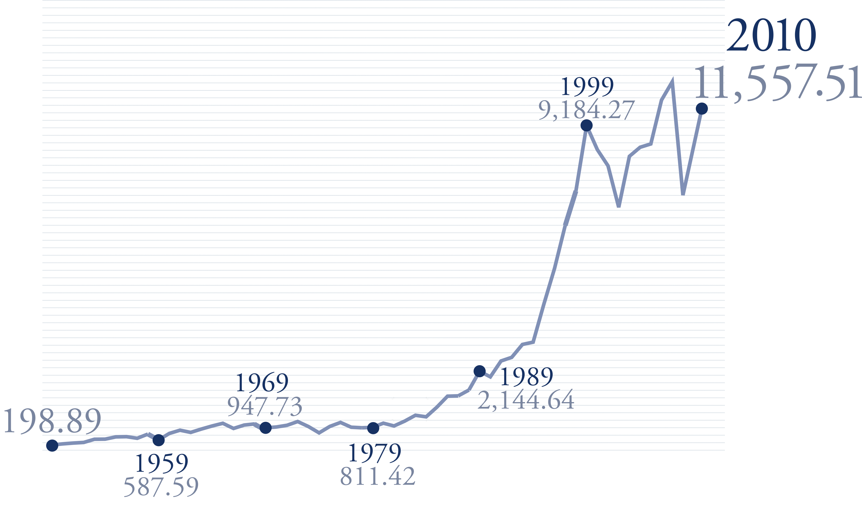
Notes:
Bear Market

Slide 74
In closing
Becoming a top tier Advisor is simple, but it is not easy. If you perceive yourself as a $500,000 producer, you'll behave in the manner of a $500,000 producer. We always underestimate ourselves
The more you stand away from the crowd, the less important price becomes
Two things never change
People who are enthusiastic make more money than people who are not enthusiastic

